Slide 1
Graphical User Interface / Events
Colm Bennett

Slide 2
GUI & Java Swing
Previous session, Graphical User Interface (GUI) & Java Swing, covered,
The primary Java GUI package javax.swing.*
Examples of top level containers e.g. JFrame graphical window that can be used to hold other components,
JButton & JLabel
JTextField & JTextArea
JCheckBox
JRadioButton & ButtonGroup
How to positioning these components in the top-level container using layout containers e.g.
BorderLayout
FlowLayout
GridLayout
BoxLayout
Why don't the components do anything when we click them?
How can we fix this problem?

Slide 3
Event-Driven Programming
GUI components cause events to occur when,
Key is pressed; or
Mouse is clicked.
Events can be handled, causing the program to respond, driving the execution through events => an "event-driven" program.
Two approaches to event handling,
Read-evaluation loop e.g. Client-written loop; or
Notification-based e.g. Call-backs.
Swing uses the call-back approach.

Slide 4
Event Handling
Every time the user types a character (KeyEvent) or pushes a mouse button( MouseEvent), an event occurs.
Any object can be notified of the event,
Implement the appropriate interface; and
Be registered as an event listener on the appropriate event source.
Swing components communicate by “firing” and “handling” events.

Slide 5
Action events (ActionEvent)
ActionEvent is the most common / simple event type in Swing to represent an action occurring on a GUI component.
Created by:
Button clicks;
Check box checking / unchecking;
Menu clicks; and
Pressing Enter in a text field
etc.
Example,
A JButton object, when clicked, generates an ActionEvent object, which is handled by an ActionListener (an object whose class implements this interface).
ActionEvent
JButton
ActionListener

Slide 6
Listening for Events - Approach
Create a component e.g. JButton
Add it to the container e.g. to a JPanel
Register a listener to be notified when the component generates an event e.g. interface ActionListener
Define the callback method e.g. actionPerformed()
ActionListener
MyActionListener
+ actionPerformed(ActionEvent) : void
Alternative representation of the Interface relationship

Slide 7
Listening for Events - Java Implementation
public static void main(String[] args) {
// Create a top-level container
JFrame frame = new JFrame("FlowLayout");
frame.setMinimumSize(new Dimension(400, 200));
frame.getContentPane().setLayout(new FlowLayout());
// Step 1 - create the JButton
JButton myButton = new JButton("Click me!");
// Step 2 - add the JButton to the container
frame.add(myButton);
frame.setVisible(true);
// Step 3 - Register a listener to be notified when the
// JButton generates an event
ActionListener listener = new MyActionListener();
myButton.addActionListener(listener);
}
public class MyActionListener implements ActionListener {
// Step 4 - define the callback method e.g. actionPerformed()
public void actionPerformed(ActionEvent event){
JOptionPane.showMessageDialog(null, "Event occurred!");
}
}
Button will cause an alert with the message, "Event occurred!" when clicked.
The addActionListener method exists in many Swing components.

Slide 8
Listening for Events - Sequence
MyActionListener class is registered to listen for events from the JButton,
New Universal Modelling Language (UML) view called a Sequence Diagram.
Shows tinteractions between objects in the sequential order that those interactions occur.

Slide 9
Swing Documentation & Examples
Oracle Java SE 7 Documentation
http://docs.oracle.com/javase/7/docs/api/index.html
Oracle How to use Swing
http://docs.oracle.com/javase/tutorial/uiswing/components
Designing a Swing GUI in NetBeans IDE
http://netbeans.org/kb/docs/java/quickstart-gui.html
Creating a GUI With JFC/Swing
http://docs.oracle.com/javase/tutorial/uiswing
Using Swing Components
http://docs.oracle.com/javase/tutorial/uiswing/examples/components/index.html

Slide 10
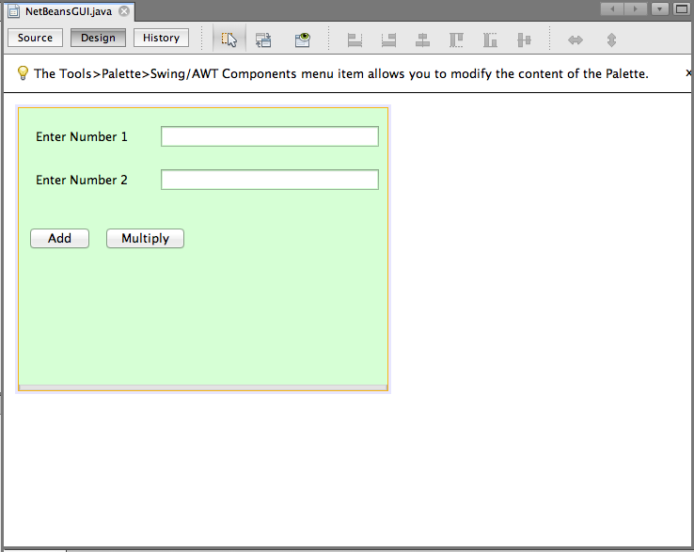
Netbeans GUI Example
Open up last week’s Netbeans GUI project
Open the NetbeansGUI.java file in Design mode

Slide 11
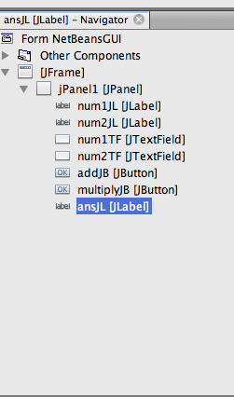
Event Handling
If we run this application right now, you will notice that neither of the buttons do anything.
We want to put this functionality in.
Before adding the functionality in – we want a label on our GUI which will eventually display the result
Add another JLabel
edit the variable name so that it is called ansJL
edit the text so that it is blank.
It will then appear in your navigator panel on the LHS

Slide 12
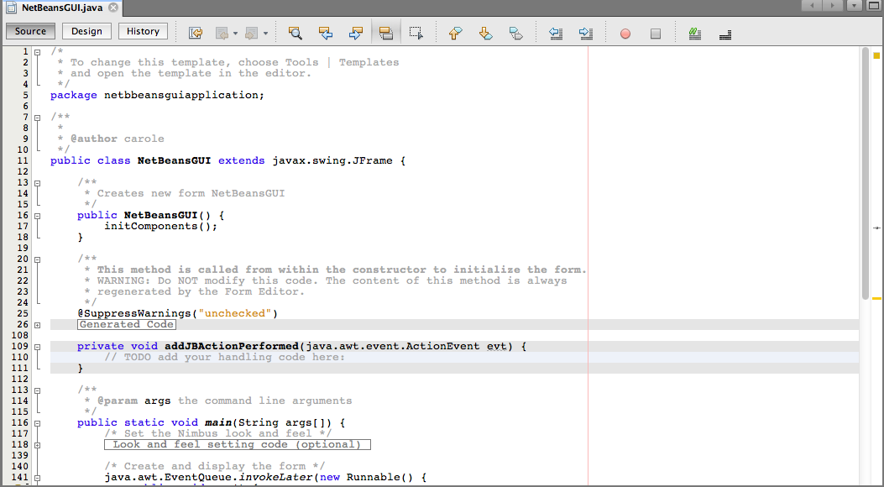
Add Event to an Object
To add an an event to an Object, double click the object – for example the Add button.
This opens the source code view and creates a method called: addJBActionPerformed
private void addJBActionPerformed(java.awt.event.ActionEvent evt){
// TODO add your handling code here:
}

Slide 13
Remove generated code
If you accidentally double click a component that you don’t actually want to create an event handler, you can’t just delete the generated empty method
Need to right click the component in design view
Then Properties
Then the Events tab
Find the generated method event and delete it
Then close the dialog box

Slide 14
Button Event
In here we write the code, to simulate the event at a button click.
We want to add the two numbers entered into the text box together.
Declare local variables to save our two numbers.
Get the values for the two JTextFields (num1TF and num2TF).
Values are saved as Strings so convert to real numbers.
Add two numbers together
Write numbers to answer label ansJL

Slide 15
Add Button ActionPerformed
private void addJBActionPerformed(java.awt.event.ActionEvent evt) {
// TODO add your handling code here:
// 1. Declare local variables for our two numbers and a place to store our answer.
double num1, num2, answer;
String num1String, num2String;
// 2. Get the text from the JTextField
num1String = num1TF.getText();
num2String = num2TF.getText();
// 3. Parse the text as a real number
num1 = Double.parseDouble(num1String);
num2 = Double.parseDouble(num2String);
// 4. Add the two numbers together
answer = num1 + num2;
// 5. Put the answer into the answer Jlabel (ansJL)
ansJL.setText(“Addition answer is: " + answer);
}

Slide 16
Multiply Button
Similarly, for the multiply we add an event listener, by double clicking the Button in the Design menu.
A method header is generated.
The code then follows the same format as before.

Slide 17
Multiply Button ActionPerformed
private void multiplyJBActionPerformed(java.awt.event.ActionEvent evt) {
// TODO add your handling code here:
double num1, num2, answer;
String num1String, num2String;
num1String = num1TF.getText();
num2String = num2TF.getText();
num1 = Double.parseDouble(num1String);
num2 = Double.parseDouble(num2String);
answer = num1 * num2;
ansJL.setText(“Multiplication answer is: " + answer);
}

